Slide 1
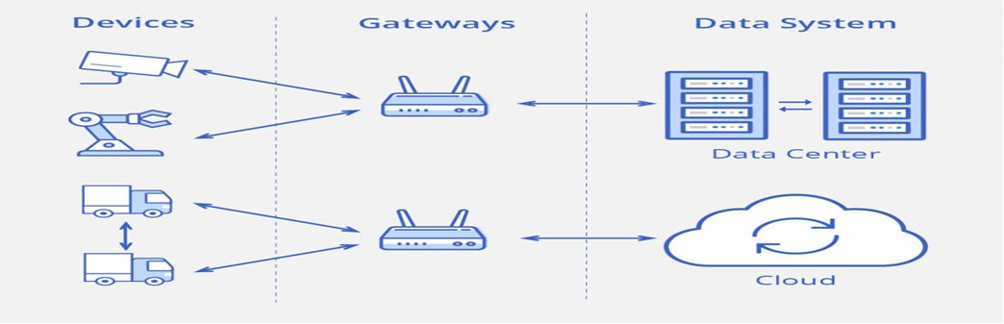
Types of IoT Connections
.
The data moves between these levels via four types of transmission channels.

Slide 2
Device to device (D2D) — direct contact between two smart objects when they share information instantaneously without intermediaries. For example, industrial robots and sensors are connected to one another directly to coordinate their actions.
This type of connection is not very common yet, because most devices are not able to handle such processes.

Slide 3
Device to gateway — telecommunications between sensors and gateway nodes. Gateways are more powerful computing devices than sensors.
They have two main functions:
To consolidate data from sensors and route it to the relevant data system;
To analyze data and, if some problems are found, return it back to the device.

Slide 4
Gateway to data systems — data transmission from a gateway to the appropriate data system.
To determine what protocol to use, you should analyze data traffic (frequency of burstiness and congestion, security requirements and how many parallel connections are needed).

Slide 5
Between data systems — information transfer within data centers or clouds. Protocols for this type of connection should be easy to deploy and integrate with existing apps, have high availability, capacity and reliable disaster recovery.

Slide 6
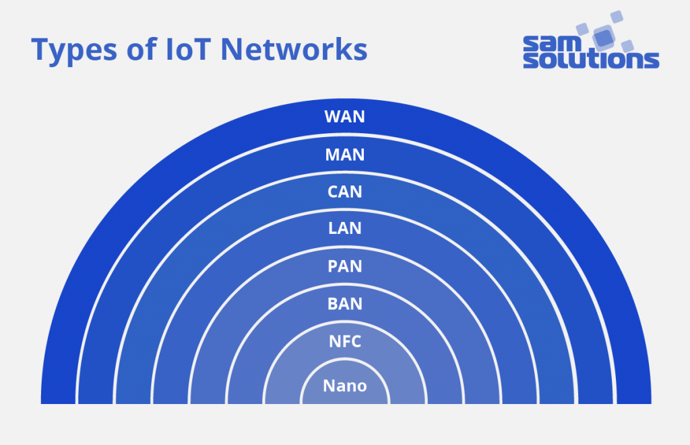
Types of IoT Networks
Networks are divided into categories based on the distance range they provide.

Slide 7
A nanonetwork — a set of small devices (sized a few micrometers at most) that perform very simple tasks such as sensing, computing, storing, and actuation. Such systems are applied in the biometrical, military.

Slide 8
NFC (Near-Field Communication) — a low-speed network to connect electronic devices at a distance within 4 cm from each other. Possible applications are contactless payment systems.
BAN (Body Area Network) — a network to connect wearable computing devices that can be worn either fixed on the body, or near the body in different positions, or embedded inside the body (implants).

Slide 9
PAN (Personal Area Network) — a net to link up devices within a radius of roughly one or a couple of rooms.
LAN (Local Area Network) — a network covering the area of one building.
CAN (Campus/Corporate Area Network) — a network that unites smaller local area networks within a limited geographical area (enterprise, university)

Slide 10
MAN (Metropolitan Area Network) — a big network for a certain metropolitan area powered by the microwave transmission technology.
WAN (Wide Area Network) — a network that exists over a large-scale geographical area and unites different smaller networks, including LANs and MANs.

Slide 11
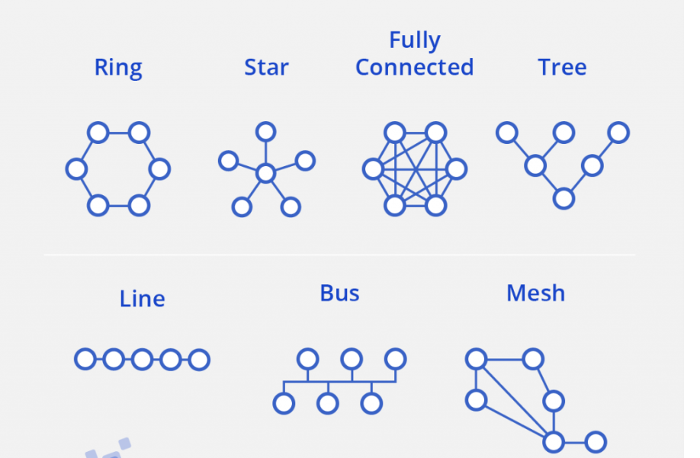
Wireless nets can also be categorized according to their topology, i.e. a connectivity configuration. There may be various combinations of connections between nodes: line, ring, star, mesh, fully connected, tree, bus.

Slide 12
Requirements for IoT Networks
The capacity to connect a large number of heterogeneous elements
High reliability
Real-time data transmission with minimum delays
The ability to protect all data flows
The ability to configure applications
Monitoring and traffic management at the device level
Cost-effectiveness for a large number of connected objects

Slide 13
Near-field communication (NFC) is a set of communication protocols that enable electronic devices, one of which is usually a portable device such as a smartphone, to establish communication by bringing them within 4 cm (1​¹⁄₂ in) of each other.
Near Field Communication (NFC) is a contact-less communication technology based on a radio frequency (RF)
NFC devices are used in contactless payment systems, similar to those used in credit cards and electronic ticket smart cards

Slide 14
The major advantage of NFC over bluetooth is that it requires much less power consumption than Bluetooth.

Slide 16
But this power saving does have some major drawbacks.
First and the foremost is that the range of transmission of NFC is much shorter than Bluetooth which is a major drawback.
NFC has a range of around 10 cm, just a few inches whereas Bluetooth connections can transmit data up to 10 meters or more from the source.
Another drawback is that NFC is quite a bit slower than Bluetooth. NFC can transmit data at a maximum speed of just 424 kbit/s, whereas Bluetooth 2.1 can transmit 2.1 Mbit/s

Slide 17
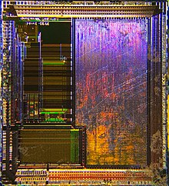
The Secure Element chip. This is an NFC chip that contains data such as the SEID (Secure Element Identifier) for secure transactions. This chip is commonly found in NFC enabled devices

Slide 18
Each full NFC device can work in three modes:
NFC card emulation Enables NFC-enabled devices such as smartphones to act like smart cards, allowing users to perform transactions such as payment or ticketing.
NFC reader/writer Enables NFC-enabled devices to read information stored on inexpensive NFC tags embedded in labels or smart posters.
NFC peer-to-peer Enables two NFC-enabled devices to communicate with each other to exchange information in an ad hoc fashion.
It operates within the globally available and unlicensed radio frequency ISM band of 13.56 MHz

Slide 19
The two modes are:
Passive The initiator device provides a carrier field and the target device answers by modulating the existing field. In this mode, the target device may draw its operating power from the initiator.
Active Both initiator and target device communicate by alternately generating their own fields.
A device deactivates its RF field while it is waiting for data.
In this mode, both devices typically have power supplies.

Slide 20
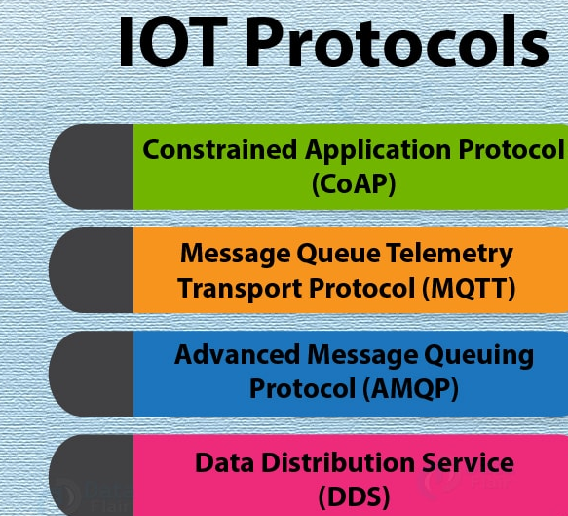

Slide 21
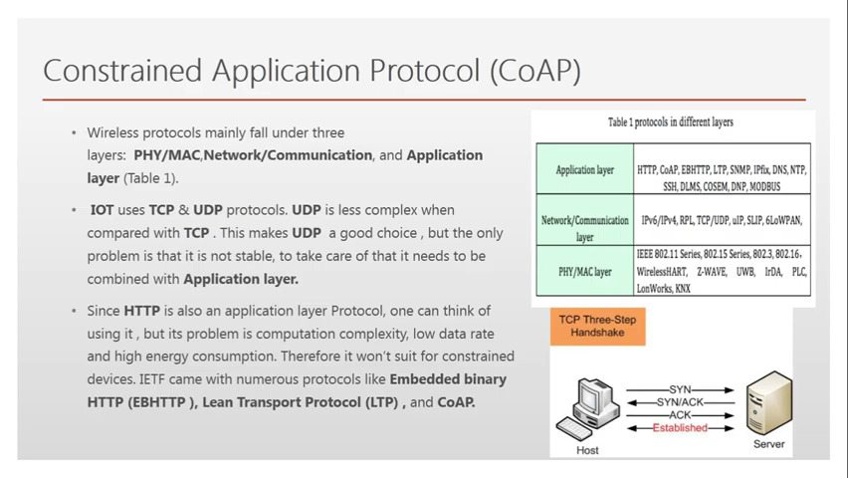

Slide 22
Constrained Application Protocol (CoAP)
CoAP is an internet utility protocol for constrained gadgets.
It is designed to enable simple, constrained devices to join IoT through constrained networks having low bandwidth availability.
This protocol is primarily used for machine-to-machine (M2M) communication and is particularly designed for IoT systems that are based on HTTP protocols.
CoAP makes use of the UDP protocol for lightweight implementation. It also uses architecture, which is just like the HTTP protocol

Slide 23
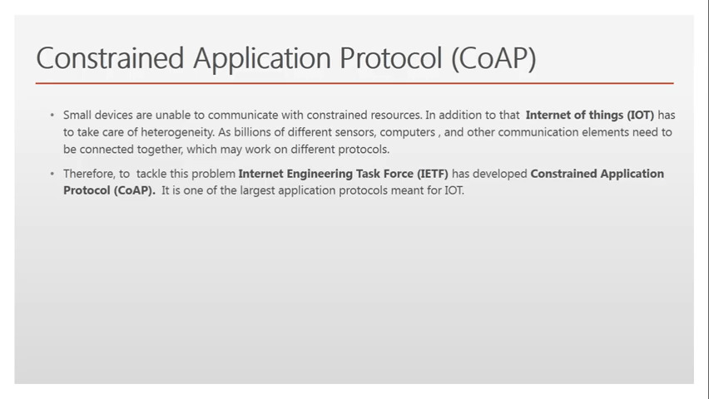
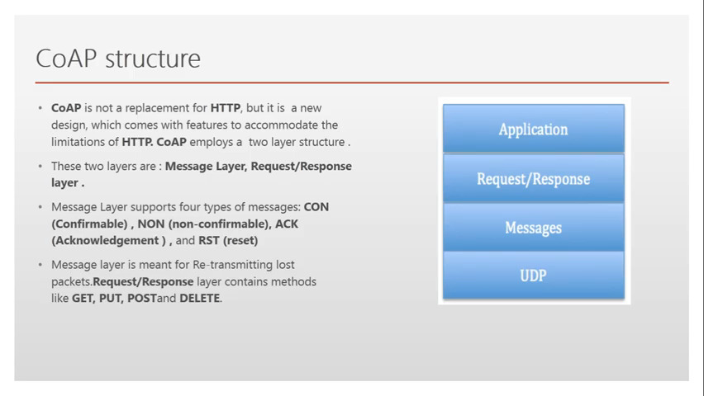

Slide 24
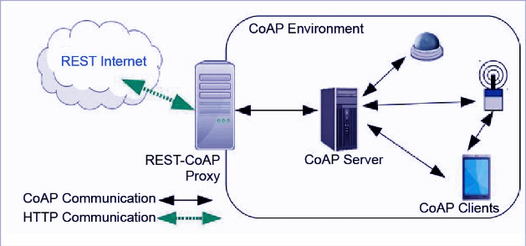

Slide 25
Popular Internet of Things Protocols, Standards and Communication Technologies
MQTT
MQTT (Message Queue Telemetry Transport) is a lightweight protocol for sending simple data flows from sensors to applications and middleware.
The protocol functions on top of TCP/IP
MQTT suits small, cheap, low-memory and low-power devices.
Includes three components: subscriber, publisher and broker.
The publisher collects data and sends it to subscribers.
The broker tests publishers and subscribers, checking their authorization and ensuring security.

Slide 26
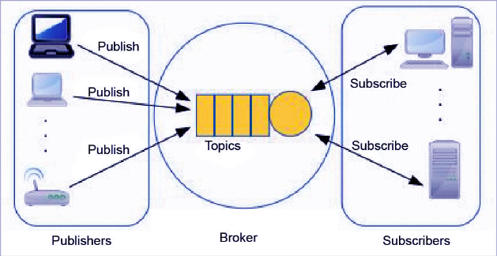
The writer generates the information and transmits the facts to subscribers through the dealer. The dealer guarantees safety by means of move-checking the authorization of publishers and subscribers.

Slide 27
DDS DDS (Data Distribution Service) is an IoT standard for real-time, scalable and high-performance machine-to-machine communication. It was developed by the Object Management Group (OMG).
The DDS standard has two main layers:
* Facts centric submit-subscribe (dcps)
* Statistics-local reconstruction layer (dlrl).
dcps plays the task of handing over the facts to subscribers, and
dlrl layer presents an interface to dcps functionalities, permitting the sharing of distributed data amongst IoT enabled objects.

Slide 28
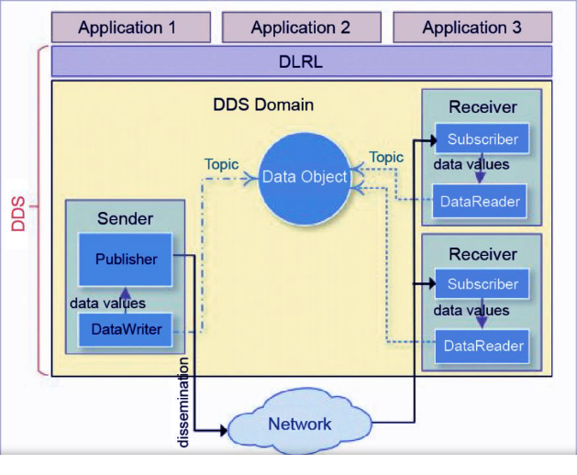

Slide 29
DDS
It enables a scalable, real-time, reliable, excessive-overall performance and interoperable statistics change via the submit-subscribe technique. DDS makes use of multicasting to convey high-quality QoS to applications.
DDS is deployed in platforms ranging from low-footprint devices to the cloud.

Slide 30
AMQP
AMQP (Advanced Message Queuing Protocol) is an application layer protocol for message-oriented middleware environments. It is approved as an international standard.
It supports reliable verbal exchange through message transport warranty primitives like at-most-once, at least once and exactly as soon as shipping.

Slide 31
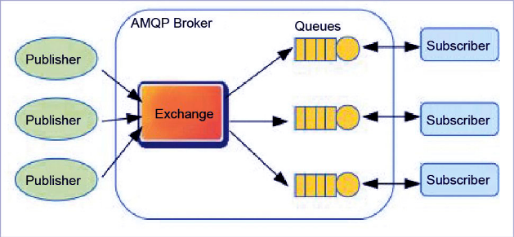
AMQP

Slide 32
The AMQP – IoT protocols consist of hard and fast components that route and save messages within a broker carrier, with a set of policies for wiring the components together.
The AMQP protocol enables patron programs to talk to the dealer.
This version has the following three additives,
which might link into processing chains in the server to create the favored capabilities.
Exchange: Receives messages from publisher primarily based programs and routes them to ‘message queues’.
Message Queue: Stores messages until they may thoroughly process via the eating client software.
Binding: States the connection between the message queue and the change.

Slide 33
Which broker to use?
One of the most popular and commonly used is the mosquito broker.
Mosquitto is an open source message broker that implements the MQTT protocol.
It’s lightweight and suitable for use on all devices from a low power single board like Arduino, ESP8266 to full computers and servers.
you can use a cloud-based server that implements the Mosquitto broker. That’s necessary to make your IoT projects controllable over the internet.

Slide 34
Cloud-based Mosquitto brokers are many, like:
ThingMQ
ThingStudio
MQTT.io
Heroku
CloudMQTT

Slide 35
CloudMQTT is one of the best and easiest cloud-based Mosquitto broker.
CloudMQTT has a free plan that allows you to set up your own CloudMQTT broker instance.

Slide 36
How to use CloudMqtt
1- Go to the cloudmqtt and register an account.
2- Then press on the “+ create new instance” green button to get an instance of the MQTT based mosquito cloud broker that cloudMqtt offer.
3- Just write the broker instance name, like: “My_MQTT_Broker_Instance” and press “create new instance”

Slide 37
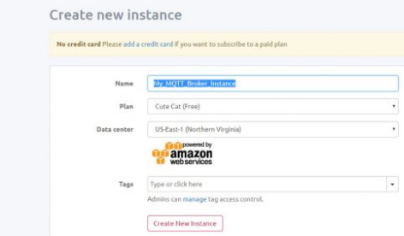

Slide 38
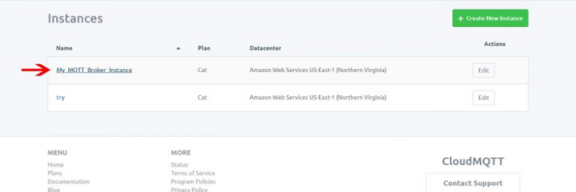
4. created a broker instance, named it “try” you will find only the one you have created. Press on its name to see the details.

Slide 39
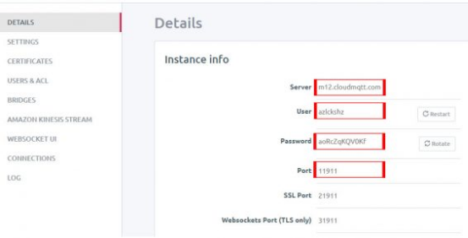
5. Here you can find the authentication details that any device will need to connect to your broker. We are interested only in the first 4 parameters.

Slide 40
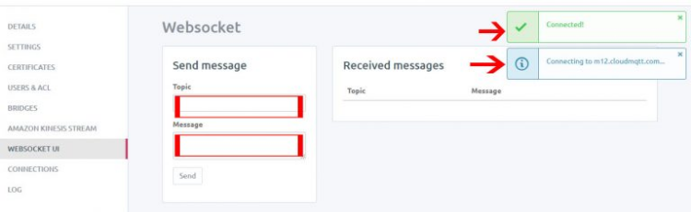
6- cloudMqtt offers a feature which is the WebSocket UI that allows you to monitor and publish and subscribe happens within this broker.

Slide 41
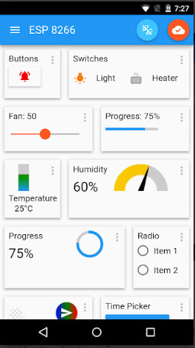
use an application to connect the phone to the CloudMQTT broker.
chosen “IoT MQTT Panel Pro”.
it has many UI components to use as a visual indicator for the subscribed and published topics.
https://1sheeld.com/mqtt-protocol

Slide 42
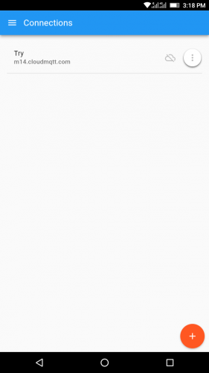
Steps:
1- After downloaded, open the App.
2- Then press on the “+” button to enter the broker authentication data.

Slide 43
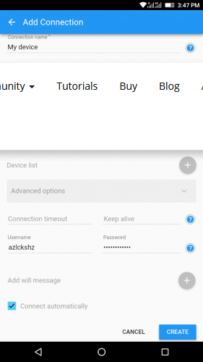
3- Enter the broker data as follows

Slide 44
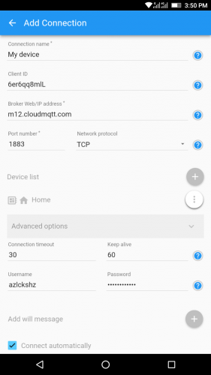
4- Then on the “Device list” press the “+” button and add a device that will connect to this broker. Let’s call it “Home”. Then press the “create” button.

Slide 45
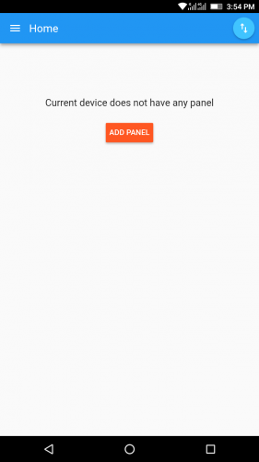
6- Let’s add some a button to use it to visualize publishing and a bar to visualize subscribing. Press “ADD PANEL” button.

Slide 46
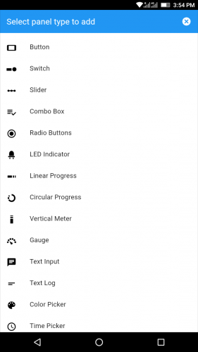
7- You will see a list of many buttons and figures.

Slide 47
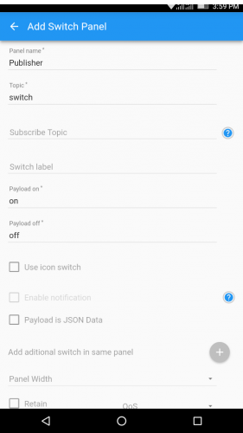
Then fill in the fields with the Panel name, the Topic which is “switch”, the message to be sent when the switch is on “called here Payload on

Slide 48
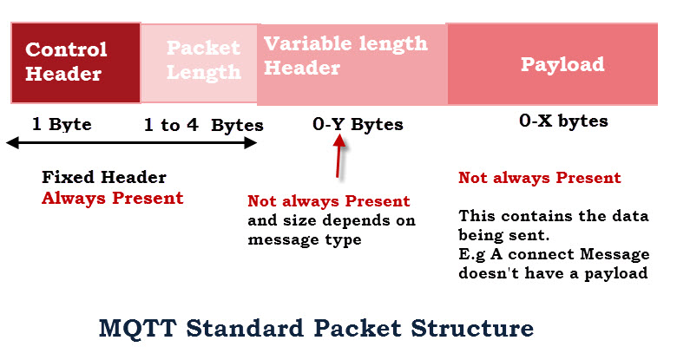
The MQTT packet or message format consists of a 2 byte fixed header (always present) + Variable-header (not always present)+ payload (not always present).
The fixed header field consists of the control field and the variable length packet length field.

Slide 49
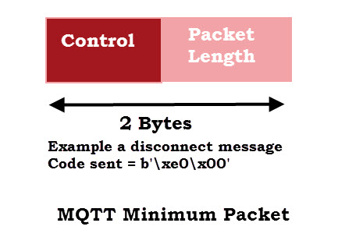
The minimum packet size is just 2 bytes with a single byte control field and a single byte packet length field.

Slide 50
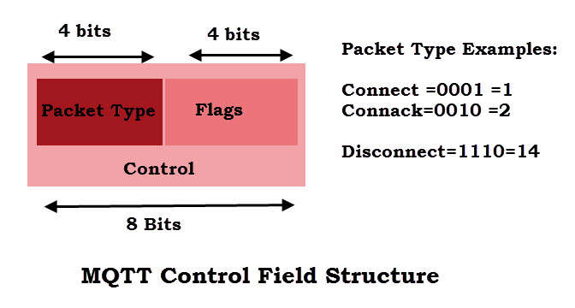
The Control Field
The 8 bit control field is the first byte of the 2 byte fixed header. It is divided into two 4 bit fields,and contains all of the protocol commands and responses.
The first 4 Most significant bits are the command or message type field and the other 4 bits are used as control flags.

Slide 51
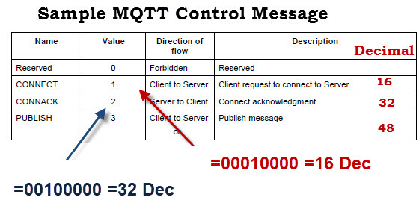

Slide 52
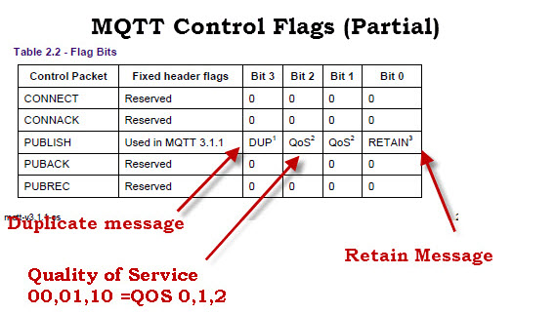

Slide 53
LoRaWAN
LoRaWAN (Long Range Wide Area Network) is a protocol for wide area networks. It is designed to support huge networks (e.g. smart cities) with millions of low-power devices.
LoRaWAN can provide low-cost mobile and secure bidirectional communication in various industries.

